Slide 1
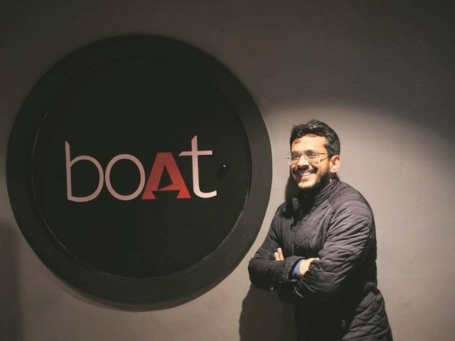
TEAM:KING57
SUMIT KUMAR
IIT GUWAHATI

Slide 2

About Boat
MARKET STRUCTURE
Distribution Network: The growth of the boAt company is mainly driven by its distribution partnerships. Initially, the company was selling its products and devices on Amazon, Flipkart, Myntra, and Jabong. Recently the company started its retailing at several Croma outlets and on the official website.
Indian Customers:
The BoAt knows that Indians are middle class & they wanted branded earphones at low prices.
Boat provides affordable, durable, and more importantly, ‘fashionable’ audio products and accessories to millennials.
Much of India is humid throughout the year. The boAt launched water-resistant and sweat-proof hearable products.
Indians loved the bass when listening to music, so they added more bass to their wearable products & this alone was the factor that improved the product's quality.
The benefit of the Crisis: During Covid years of 2020, about 60 lakh students graduated in India and all were in their 20s, and Covid led to WFH. Looking at this market BoAt targeted the majority of Indian youth and music lovers.
BoAt (legal name "Imagine Marketing Services Pvt. Ltd.") is an India-based company which was incorporated in November 2013. BoAt markets earphones, headphones stereos, travel chargers, and premium rugged cables.
King57

Slide 3
Competitive Advantage
BoAt found the market gaps and conquered them aggressively via pricing strategies.
Amidst the most expensive audio brands in the world, boAt managed to produce cost-effective products that led to its traction in Indian Market.
BoAt regularly offers discounts and promotions on their website.
King of Audio Industry: It has captured 32% of the market share and is India's fastest-growing audio brand.
Word-of-mouth marketing:It is also critical for boAT's success. They have leveraged their strong and loyal customer base to spread the word about their products via community-building initiatives.
SEO: For online digital marketing, the company invested heavily in search engine positioning so that they appear as the top result when users search for keywords related to their products.
BoAt excellent marketing strategies.
Established a personal connection with the audience: This is evident in their social media presence, which is very engaging and relatable.
The brand started talking to the consumers in their language: Millennials started identifying themselves with the product.
King57

Slide 4
ANALYSIS ON MARKETING STRATEGIES :
Let’s Plug Into Nirvana
BoAt produces limited editions of its various audio hardware products as part of promotions or collaborative tie-ins with other brands.
Boat uses influencers wisely by partnering with relevant influencers who have a genuine connection with the brand's identity.
An ambassador for the music industry. : Neha Kakkar and Diljeet Dosanjh, who are also Boat’s brand ambassadors, are two of the biggest stars in the music industry.
Tanning is Asia’s largest music festival, and boats sponsor this event.
IPL 2021 six teams collaborate on a boAt: BoAt managed the whole campaign ‘What Floats Your BoAt’ of BoAt with celebrities like Rishabh Pant, Shikhar Dhawan, Vicky Kaushal, Prithvi Shaw, Karthik Aryan, and Kiara Advani.
BoAt utilized social media platforms such as Facebook and Instagram to reach its target audience.
Word-of-mouth marketing: Word-of-mouth spread like wildfire for the D2C brand. This has allowed them to get positive reviews which have further boosted sales.
Lakme Fashion Week: At fashion events, brands are advertised as fashion accessories. The model walks the ramp with a boAt product. boAt has collaboration with Lakme Fashion Week.
The brand started talking to the consumers in their language: Millennials started identifying themselves with the product.
boAt sponsors the Sunburn Music Festival.
Women’s Day campaign:‘#DanceThroughLife’.
King57

Slide 5

Financials
“We have fulfilled only 20 percent of the demand. The market is huge, and we have to get our team and finances right to serve it.” – Aman Gupta , Founder
Aman Gupta and Sameer Mehta bootstrapped BoAt by investing 30 lakhs from their wealth in 2016.
It earned a revenue of ₹1,531 crores & the profit was around ₹127.1 crores in FY2021. Its earnings grew by 61% from ₹48.85 crores in FY20 to ₹78.6 crores in FY21.
Boat on the road to become a Rs 500-crore consumer electronics company by 2024.
BoAt achieved $500 million (approximately Rs 4000 crore) in net sales for the first time in FY2023, a 20-22% growth over last year.
BoAt leads the hearables segment with a 30.6% market share as of Q1 2023, as per IDC India. Nearly 70% of the company’s revenues come from audio products, a segment where it grew 82% on-year in the first quarter of 2023.
King57

Slide 6
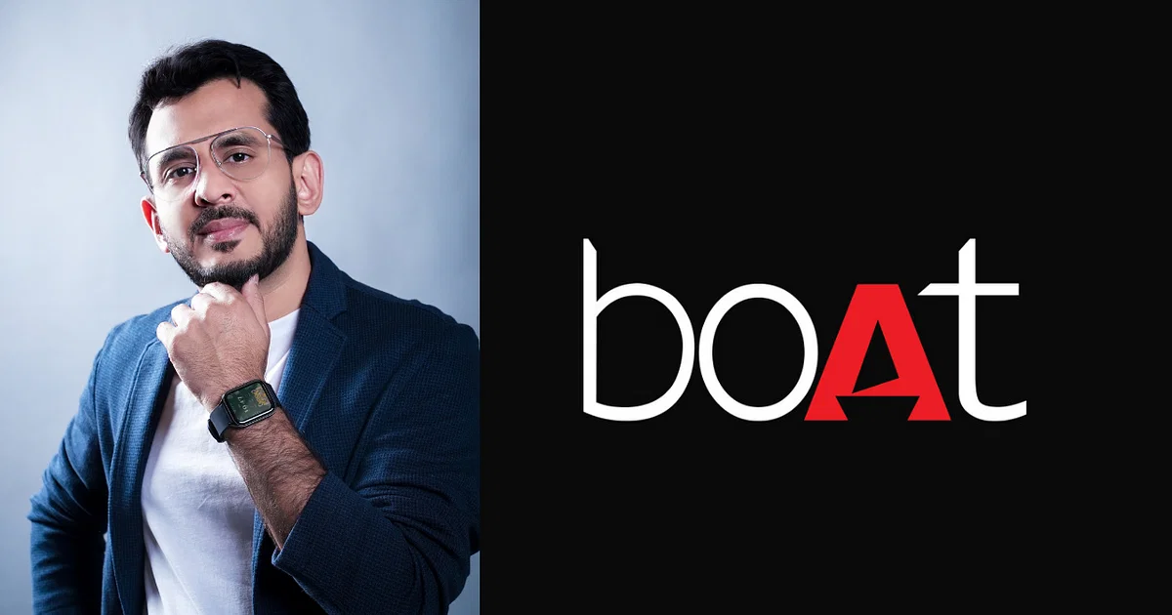




Thank You
Sumit Kumar
6203987158
sumitkumar4557ch@gmail.com
Team: King57
King57

